Slide 1
Operating Systems
CS3281 / CS5281
Spring 2026

Slide 2
Team
Instructor
Mohammad Kavousi
Graduate TAs
Weiheng Qiu, Ke Li
Graders
Tobenna Udeze, Jiashu Zhu, Haowei Fu, Alex Galvez

Slide 3
Top Hat
You will receive an email for your section. Please join.
Visit https://www.tophat.com and enter the join code:
Section 1: 538765
Section 2: 121371
Section 3: 796689

Slide 4
Important Links
Textbook | http://pages.cs.wisc.edu/~remzi/OSTEP/
zybook | https://learn.zybooks.com/zybook/VANDERBILTCS3281-5281Spring2026
Discussion Forum & Announcements | https://piazza.com/vanderbilt/spring2026/cs32815281
Lectures | https://github.com/cs3281/lectures (PowerPoint lectures will be published on Top Hat)
Programming Assignments | https://classroom.github.com/classrooms/30844110-cs3281-classroom-spring2026
Announcements & Administration | https://vanderbilt.edu/brightspace/

Slide 5
Office Hours
See on Github.

Slide 6
Programming Assignments
Administered through GitHub Classroom
Requires admission to the cs3281 repository using your GitHub username
Fill the following form to share your GitHub username. Use your Vanderbilt account to access the form
https://forms.office.com/r/DcaxBd2iC4

Slide 7
Programming Assignments
Graded using the VUIT-provided AWS Virtual Machines
Access your WorkSpace on a virtual machine in a browser at
https://webclient.amazonworkspaces.com
or download the AWS WorkSpaces client from: https://clients.amazonworkspaces.com/
Enter the following registration code:
SLiad+DGTNYL
Log in with your VUNetID and password
If you have any issues with logging, send a ticket to VUIT via
https://tdx.vanderbilt.edu/TDClient/33/Portal/Home/

Slide 8
Programming Assignments
Automate GitHub credentials:
Go to https://github.com/settings/tokens
Click "Generate new token (classic)"
Note: Development
Expiration: No expiration
Select scopes: repo, user, codespace
Click "Generate token“
Log into your AWS virtual machine
Copy Personal Access Token and write it down or save it somewhere
In a terminal, run "git clone https://github.com/cs3281/lectures.git"
When prompted, enter you GitHub username and enter the above-generated Personal Access Token as your password
You should never be prompted to do enter these credentials again
In a terminal, run "git config --global credential.helper store"
Git should save your token in ~/.git-credentials file
Notes:
gdbinit - User initialization file contains commands that are executed upon starting up GDB
With set auto-load safe-path setting specifies directories that GDB reads scripts from

Slide 9

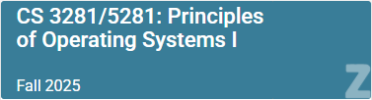
Textbook
Textbook: Operating Systems: Three Easy Pieces
Available for free at http://pages.cs.wisc.edu/~remzi/OSTEP/
zybook
An online interactive book for understanding the lecture concepts
Activities will be assigned regularly. See Brightspace for the schedule of assigning the activities
Subscription code: VANDERBILTCS3281-5281Spring2026
Use your Brightspace name, Vanderbilt email address and VUNet ID

Slide 10
Textbook
Other possible texts:
The Linux Programming Interface
Computer Systems: A Programmer’s Perspective
Linux Kernel Development

Slide 11
Course Assessment
Programming assignments: 50%
Take-home quizzes: 5%
Exam 1: 20%
Exam 2: 20%
Zybook activities: 3%
Attendance: 2%

Slide 12
Quizzes
There will be regular quizzes throughout the semester
You will do the quizzes outside class
Each quiz covers topics covered after the previous quiz
Expected to be conducted on Brightspace

Slide 13
Late days
You have a total of 4 late days that you can use across programming assignments as you wish
A maximum of two late days can be used on a given programing assignment
Example: assignment is due by 11:59pm Monday; you can use two late days to submit that assignment by 11:59pm Wednesday with no penalty
To use late days: push a file named late_days.md to the top-level directory of your assignment repo with a line stating whether you're using one or two late days
Assignments submitted more than two days late will not be accepted
No collaborations unless explicitly permitted

Slide 14
Late days
Assignments submitted on or after 12:00am the next day are required to use late days or take the late-day penalty, 20% per day
Do not wait until 11:59pm to make your first push!​
You may commit and push incremental results and are suggested to do so early and often
The last push before the deadline will be graded unless specified with late_days.md

Slide 15
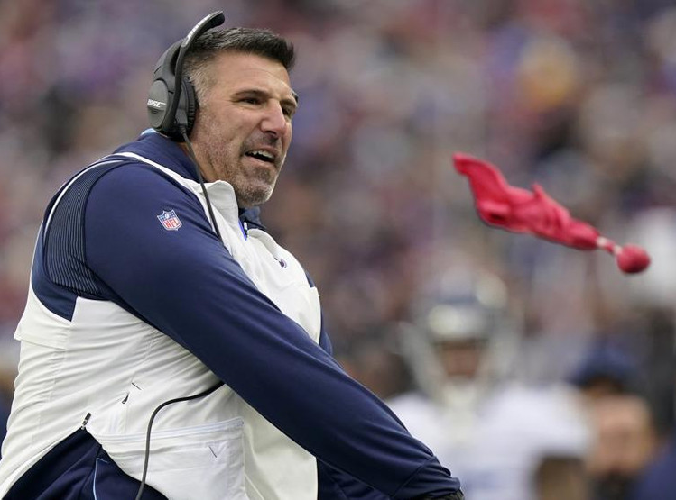
Regrade Requests
Grading errors can and do happen
Not malicious!
You can “challenge” if you believe an error was made
If you are wrong, you may lose a late day

Slide 16

ChatGPT and AI assistants
We have entered a new era with AI assistants
Our goal is to use them to enhance the learning experience
You can use ChatGPT and other AI tools however you want! Make sure to disclose how you used an AI tool
ChatGPT can be a helpful aid, but it can’t totally do your homework for you! Sometimes, it can lead you off track, so think critically about its outputs

Slide 17
Course expectations
You are expected to attend class​ and participate in class discussions
All assignments are released in GitHub Classroom. You will access the assignments via Brightspace

Slide 18
Course expectations: Office Hours
We will use an office-hour policy similar to the one listed here: https://www2.seas.gwu.edu/~gparmer/resources/2021-09-20-Office-Hours-HOWTO.html
Please read this policy carefully and adhere to its guidelines
It will help you and us
Notes:
Show tests, explain expected and actual behavior, come to office hours for asking specific questions on code
Use a good style for programming – Put comments, Use descriptive variable names

Slide 19
Development Environment
This course will use C
This is an OS course, not a course on C
While some C material will be discussed, it is up to you to learn and build your proficiency in C if you aren’t proficient already
Remember, you can ask ChatGPT for help!
We will use Ubuntu (a Linux distribution) as the development environment
VMs provided through VUIT
You’re free to choose your development environment, but your work will be tested and evaluated on the Ubuntu VM environment
We do not support alternative environments
We will use GitHub and git for content and assignment management

Slide 20
Development Environment
We will use the MIT-sponsored “xv6” teaching OS for most assignments
Based on the original UNIX kernel
Allows us to actually hack on a real kernel
Runs on a RISC-V architecture which will be emulated on your VM through the QEMU application
Good idea to read relevant sections of the “xv6 book” while doing homework assignments: https://pdos.csail.mit.edu/6.S081/2023/xv6/book-riscv-rev3.pdf
Exit xv6/QEMU by pressing “Ctrl+a” followed by “x”
Notes:
xv6 runs on multi-core RISC-V

Slide 21
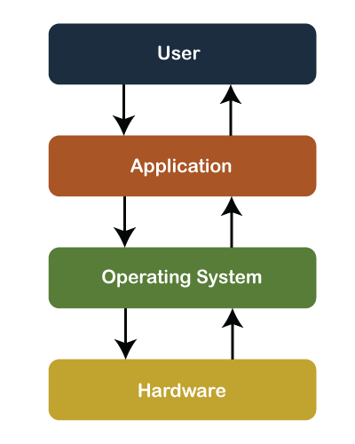
Course Goals
Understand operating systems by learning their architecture and services
Experience with low-level systems development

Slide 22
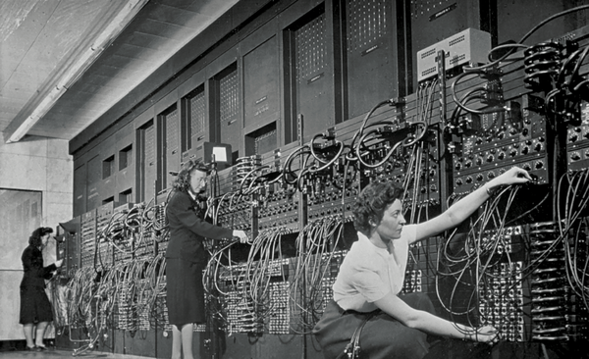
Historical Perspective
Eniac (Electronic Numerical Integrator and Computer)‒ World’s first programmable general-purpose computer
Early computers did not have an operating system. People manually performed functions that are now controlled in software systems that operate the machine
Notes:
https://www.nytimes.com/2019/02/13/magazine/women-coding-computer-programming.html
Coding services in the assembly language
No keyboards and screen

Slide 23
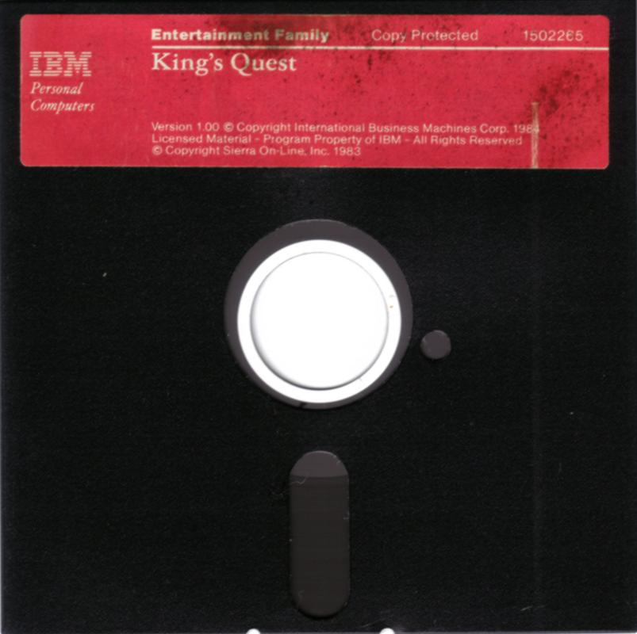
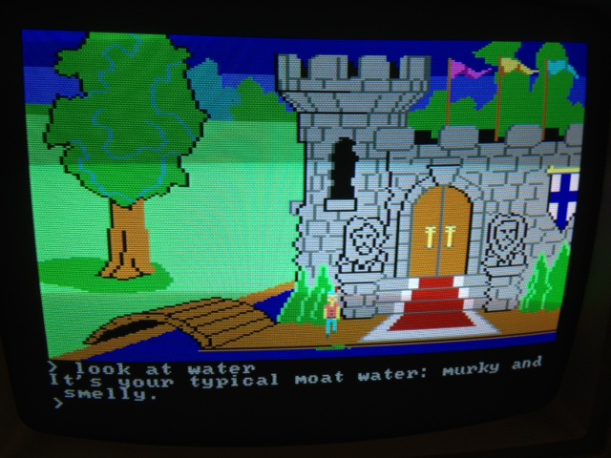
Before operating systems
User could only run one program at a time.
Had to insert the program disk before booting the machine.
Program had to control the hardware directly
An example (at right): 1983 “King’s Quest” game for IBM PC Jr.

Slide 24
Embedded systems often run without OSes
“Bare-metal” embedded systems
Application must handle:
Boot, initialization and hardware
Applications are not portable
Rewrite, mostly from scratch, for a new “Oven Controller”
No memory allocations, no coding “errors”
Instead, invalid memory accesses would crash the whole system

Slide 25
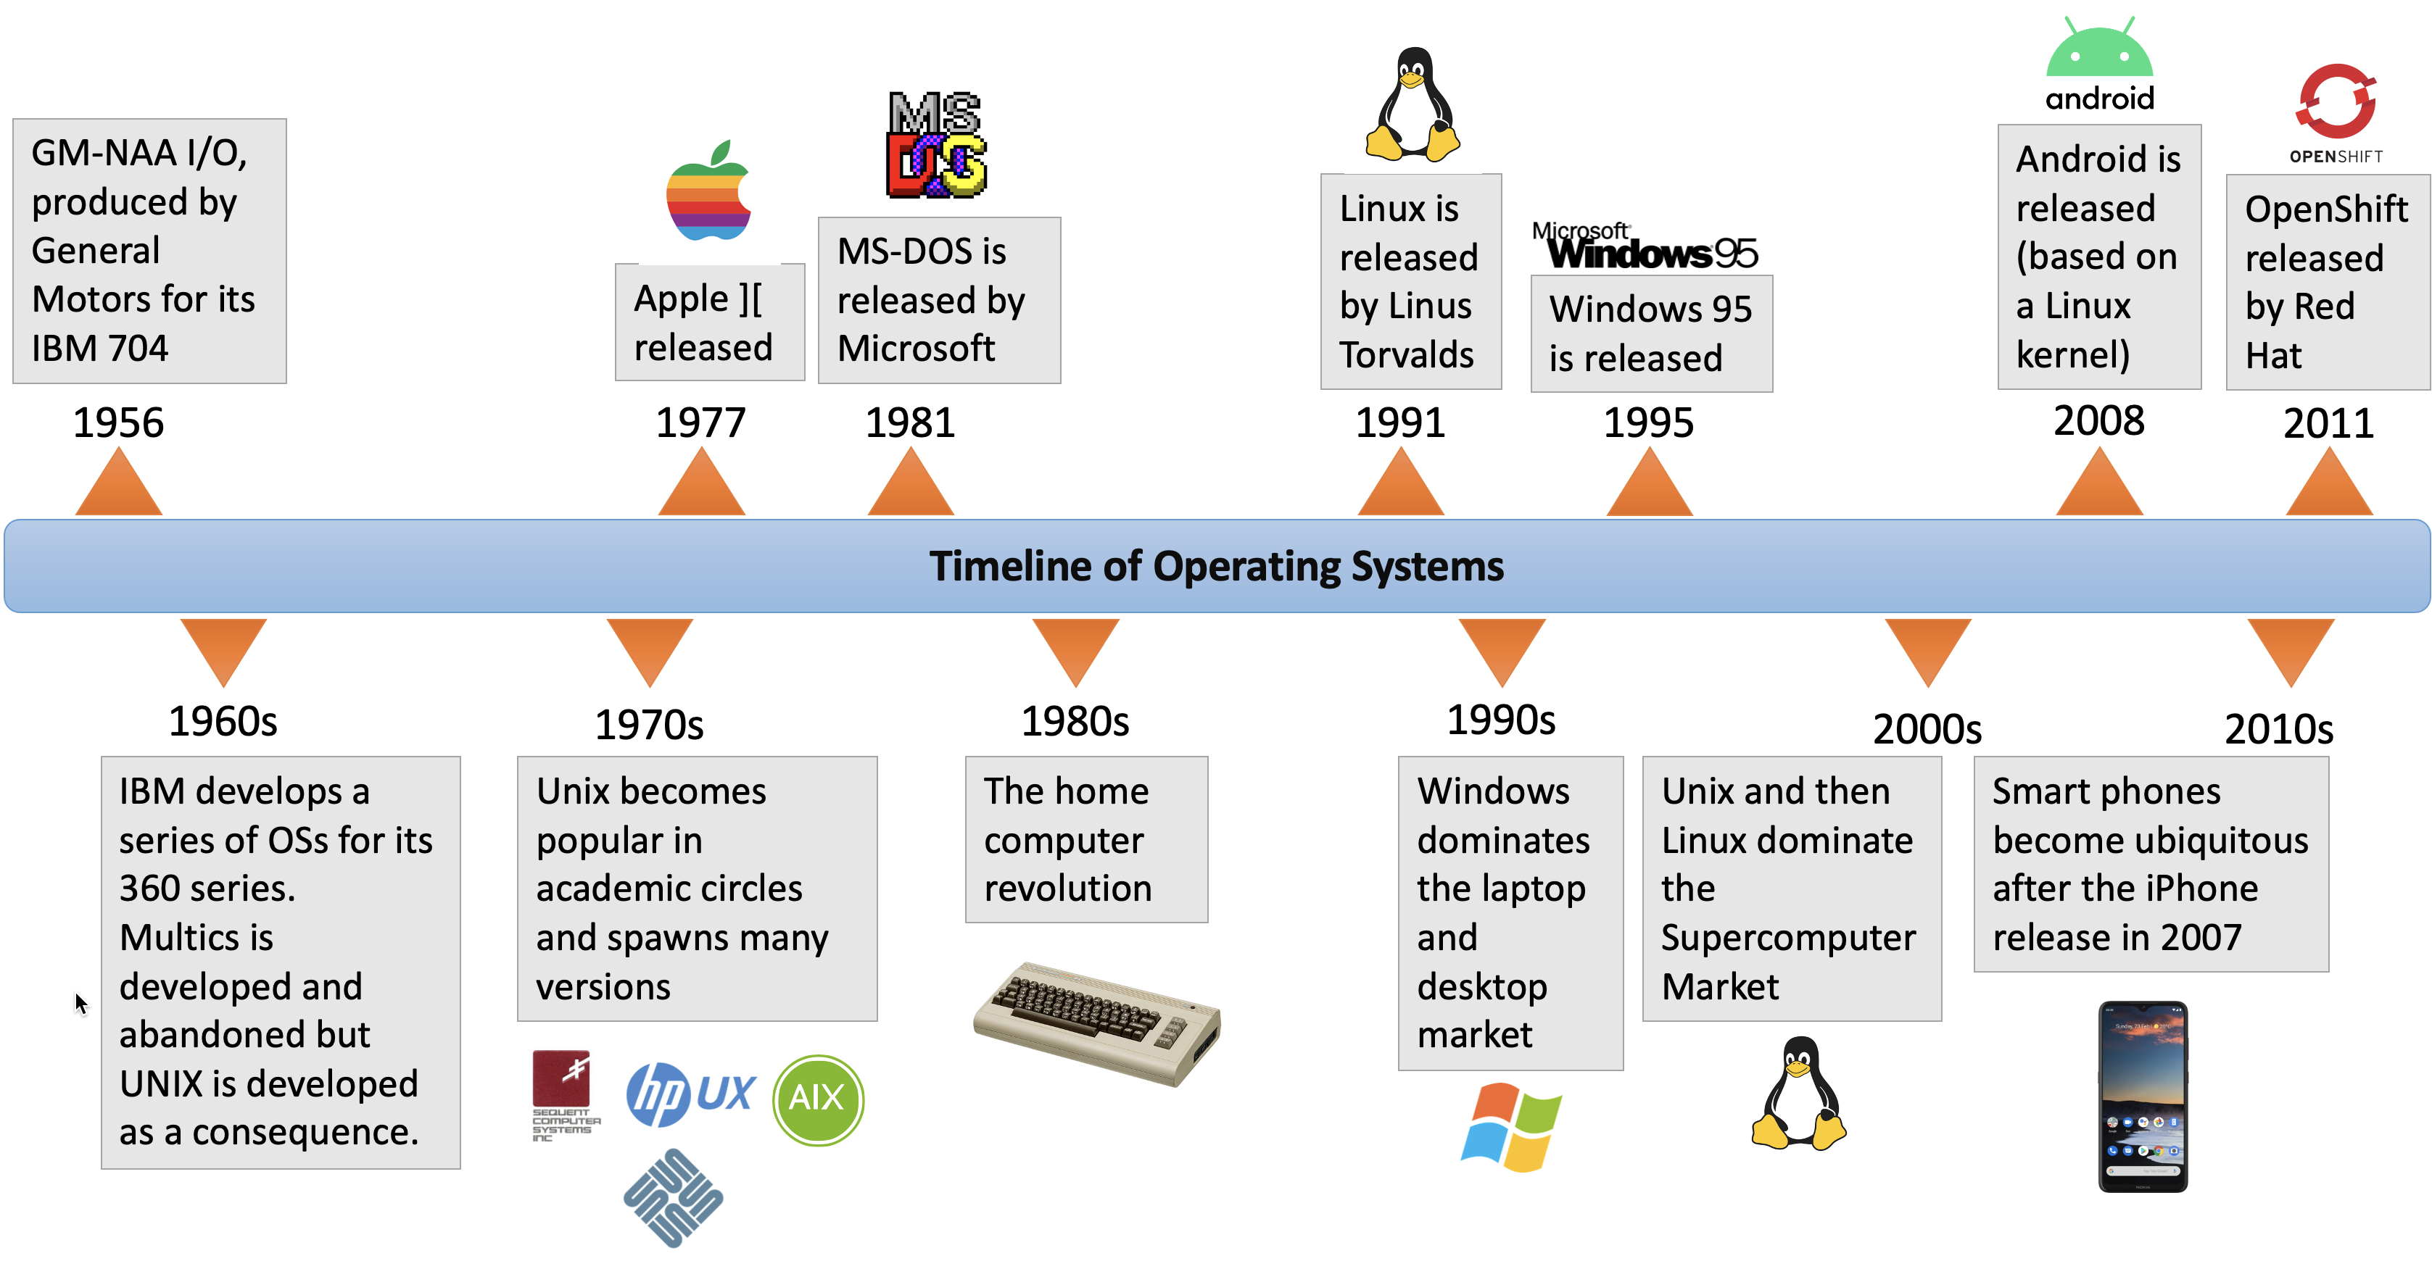
History of Operating Systems – a brief timeline
https://medium.com/@tanalpha-aditya/introduction-to-operating-systems-and-networks-dfa3611befcc

Slide 26
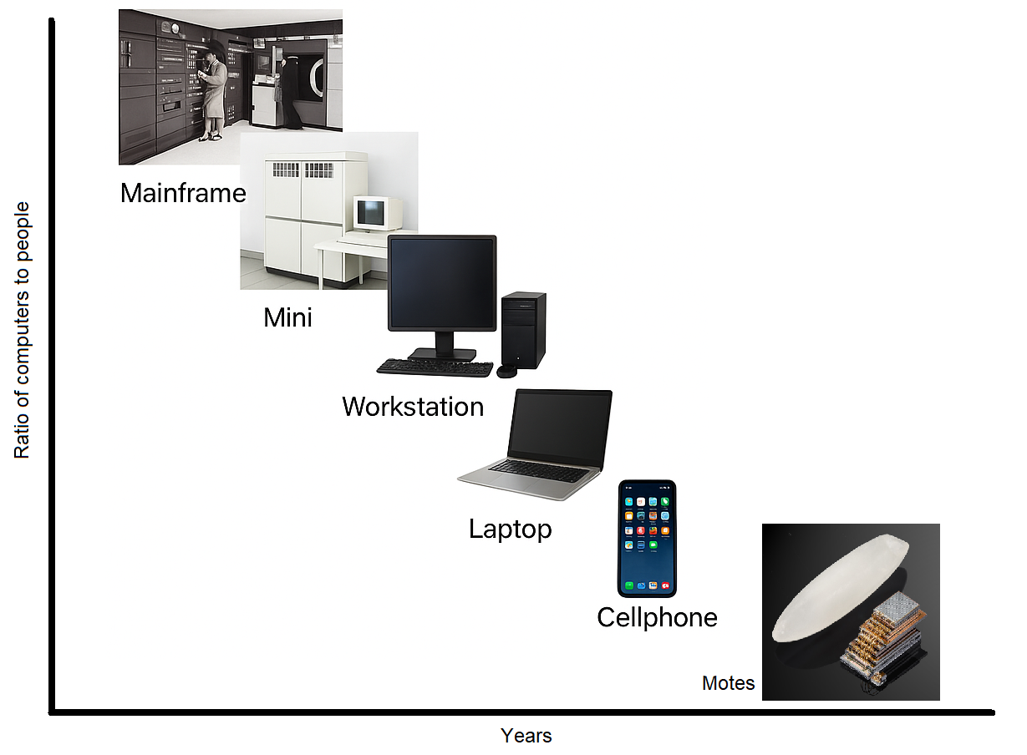
Computers come in diversity

Slide 27
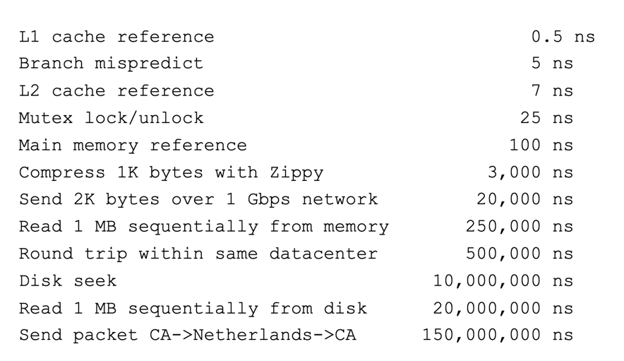
Computing timescales are increasingly large
Jeff Dean (Google AI): “Numbers Everyone Should Know”

Slide 28
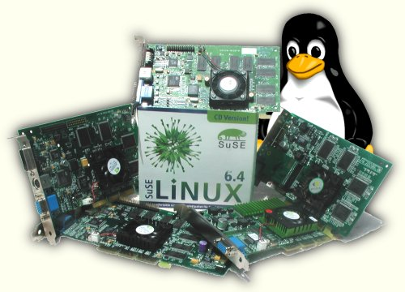
OSes at the heart of these challenges
Operating system is a software that runs on the bare hardware of a computer
Operating system is responsible for
Abstracting the hardware details for convenience and portability
Notes:
Provide abstractions to applications to enable hardware compatibility
Why: allow reuse of common features, avoid low-level details
Challenges: What are the correct abstractions?
Manage sharing of resources across many applications
Why: protect applications, enforce fair access
Challenges: What are the mechanisms and what are the policies?

Slide 29
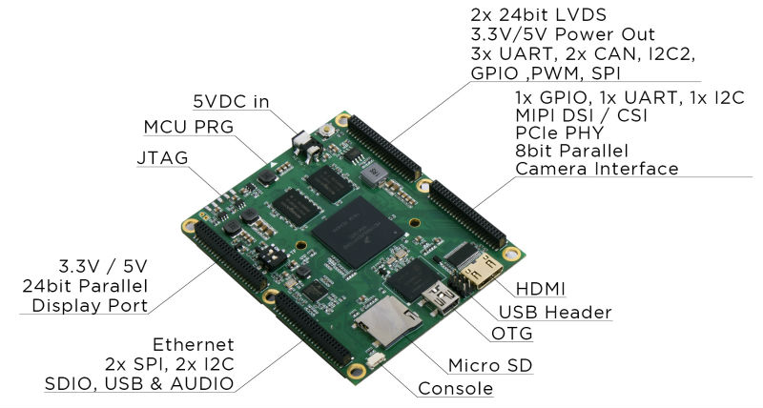

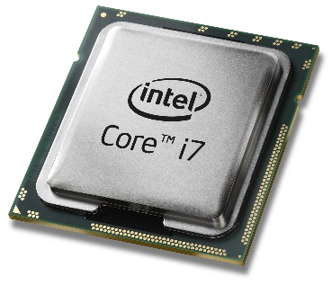
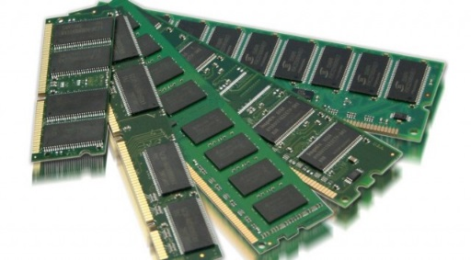
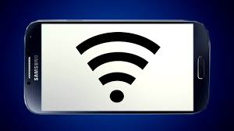
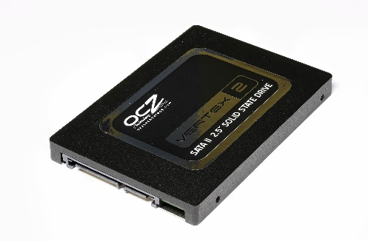
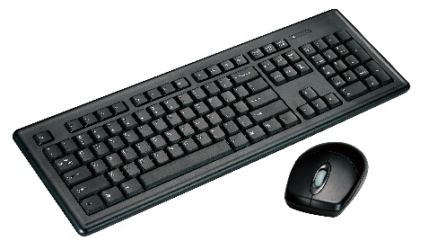
OSes at the heart of these challenges
Operating system is responsible for
Abstracting the hardware details for convenience and portability
Share hardware among multiple applications. Through virtualization, OS creates multiple virtual objects from a real object e.g., CPU and memory

Slide 30

OSes at the heart of these challenges
Operating system is responsible for
Abstracting the hardware details for convenience and portability
Share hardware among multiple applications
Isolating applications to contain bugs, enforce fair access

Slide 31
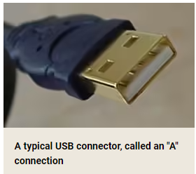
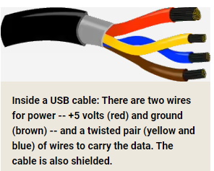
Example: USB device insertion
Consider what happens when you plug-in a USB device to your laptop
USB controller informs its driver
The driver is part of the kernel
The driver asks the device to identify itself
Device sends back an ID
Controller uses ID to match a driver to the new device
Notes:
https://superuser.com/questions/42022/how-does-usb-device-recognition-work
https://stackoverflow.com/questions/3013142/what-happens-when-you-plug-in-a-new-usb-device
Controller transfers data, e.g., device ID, between an I/O device and driver. It matches the I/O device with a driver.
Controller is a chipset inside the I/O device

Slide 32
What’s part of the Operating System?
OS Kernel: the only code without security restrictions
Process scheduling
Memory Allocation
Access hardware devices
OS Distribution: the kernel + other stuff
GUI
Command shell
Package manager
Software Libraries
Apps
Text editor, browser, SSH, etc.

Slide 33
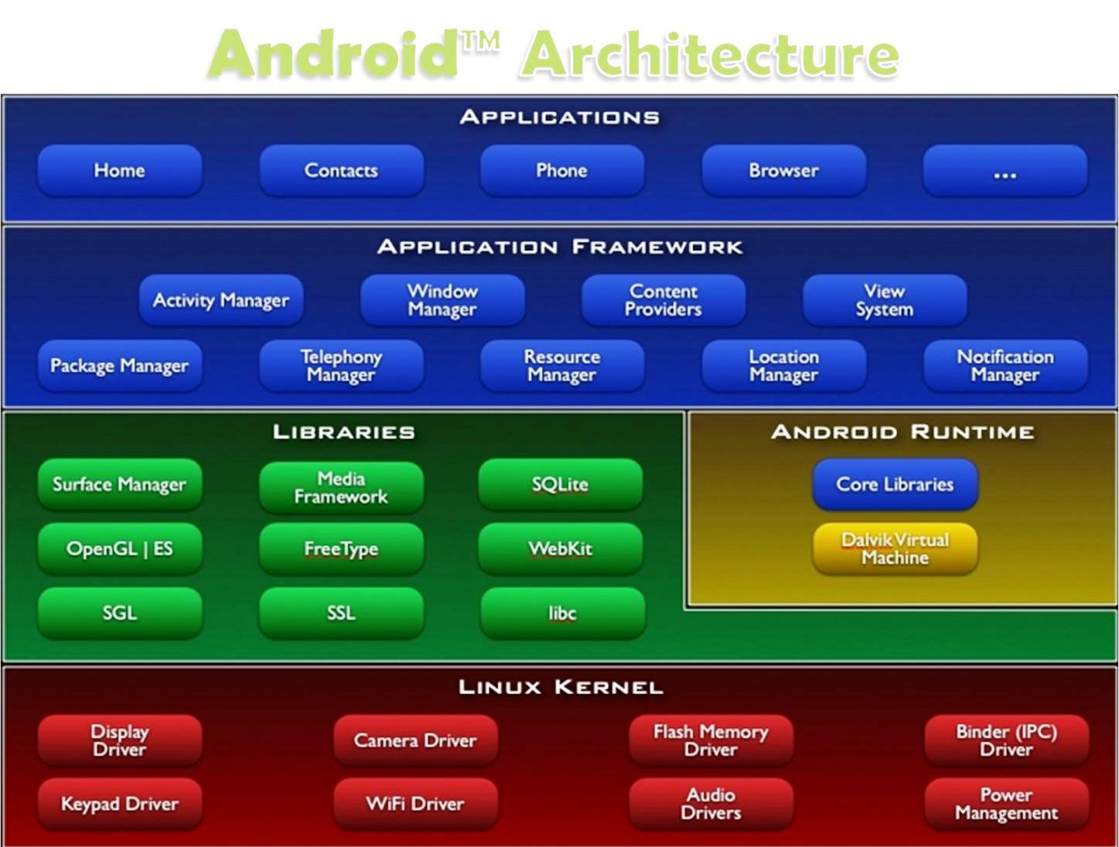
Layers of a modern computing system
Application – the user program
Application framework
Helpful libraries for providing modularity and reuse
System Libraries – the core services of the OS are encapsulated by these libraries, e.g. libc
The operating system kernel. The Kernel of an OS provides the essential services to manage the computer resources
Notes:
Application framework – reusable code e.g., classes and objects
System libraries – fundamental code such as file I/O and memory management

Slide 34
Layers of a modern computing system
Application – the user program.
System Libraries – the core services of OS are encapsulated by these libraries, e.g. libc
The operating system has full access to hardware
Notes:
Instruction set architecture defines the format of instructions and processor state

Slide 35
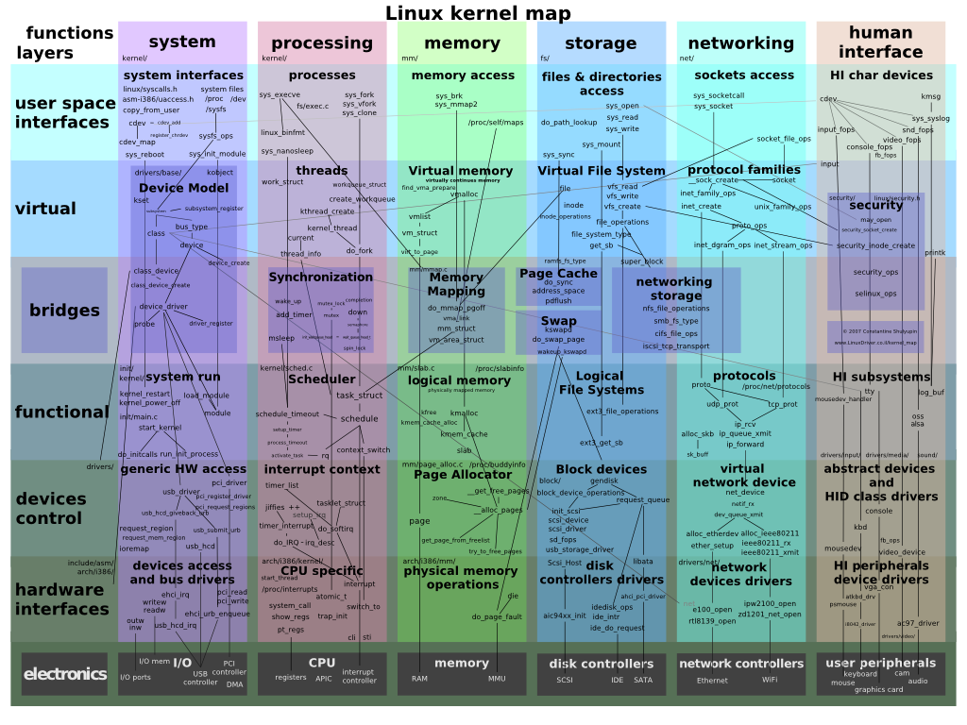
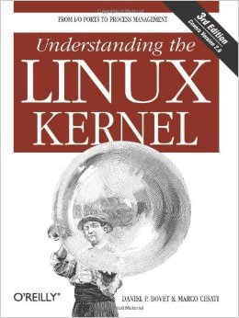
The OS Kernel

Slide 36
The OS as a Resource Manager
All applications should have good performance. They should have fast response time for interactive tasks.
One of the main tasks of an OS is to optimize the use of computational resources. The OS strives to keep CPU, memory, and I/O devices busy continuously
Notes:
https://superuser.com/questions/42022/how-does-usb-device-recognition-work
https://stackoverflow.com/questions/3013142/what-happens-when-you-plug-in-a-new-usb-device
Controller transfers data, e.g., device ID, between an I/O device and driver. It matches the I/O device with a driver.
Controller is a chipset inside the I/O device

Slide 37



Real-world roles of the Operating System
Referee
Manage protection, isolation, and sharing of resources
Resource allocation and communication
Illusionist
Provide clean, easy-to-use abstractions of physical resources
Infinite memory, dedicated machine
Higher level objects: files, users, messages
Masking limitations, virtualization
Glue
Common services
Storage, Window system, Networking
Sharing, Authorization
Look and feel

Slide 38
The OS Kernel
Process management
Memory management
Scheduling
File-system management
Communication and networking
Synchronization
Many others: users, IPC, network, time, terminals
Notes:
Filesystem allows a process to perform I/O operations on files. It creates, deletes, and updates
Security – OS protects applications against malicious applications.

Slide 39
How do we interact with the kernel?
Applications only see them via system calls (system calls are the API of the kernel)
Examples, from UNIX / Linux:
pid_t pid = getpid();
printf("mypid is %d\n", pid);

Slide 40
How do we interact with the kernel?
Applications only see them via system calls (system calls are the API of the kernel)
Examples, from UNIX / Linux:
pid_t pid = getpid();
printf("mypid is %d\n", pid);
brk(0x18c9000) = 0x18c9000
clone(child_stack=0, flags=CLONE_CHILD_CLEARTID|CLONE_CHILD_SETTID|SIGCHLD, child_tidptr=0x7fbf4bda1a10) = 3710
getpid() = 3709
fstat(1, {st_mode=S_IFCHR|0620, st_rdev=makedev(136, 6), ...}) = 0
write(1, "mypid is 3709\n", 14mypid is 3709
) = 14
exit_group(0)
strace output (system calls in bold)

Slide 41
Why OS design is challenging
The environment is unforgiving: weird h/w, hard to debug
It must be efficient (thus low-level?)
but abstract/portable (thus high-level?)
Powerful (thus many features?)
but simple (thus a few composable building blocks?)
Resource sharing: CPU and memory
Open problems: security

Slide 42
Before Next Class
Ensure that you have full access to your VUIT Amazon AWS Virtual Machine
Ensure that you can access the CS 3281 GitHub repo. Skim through the syllabus: https://github.com/cs3281/lectures
Verify access to Brightspace and Piazza

Slide 43
Additional Reference Material
https://github.com/cs3281/coding-interview-university
https://missing.csail.mit.edu/ - The Missing Semester of Your CS Education
Videos and material which will be very useful for you.

